Slide 1
Batman vs Superman

Slide 2
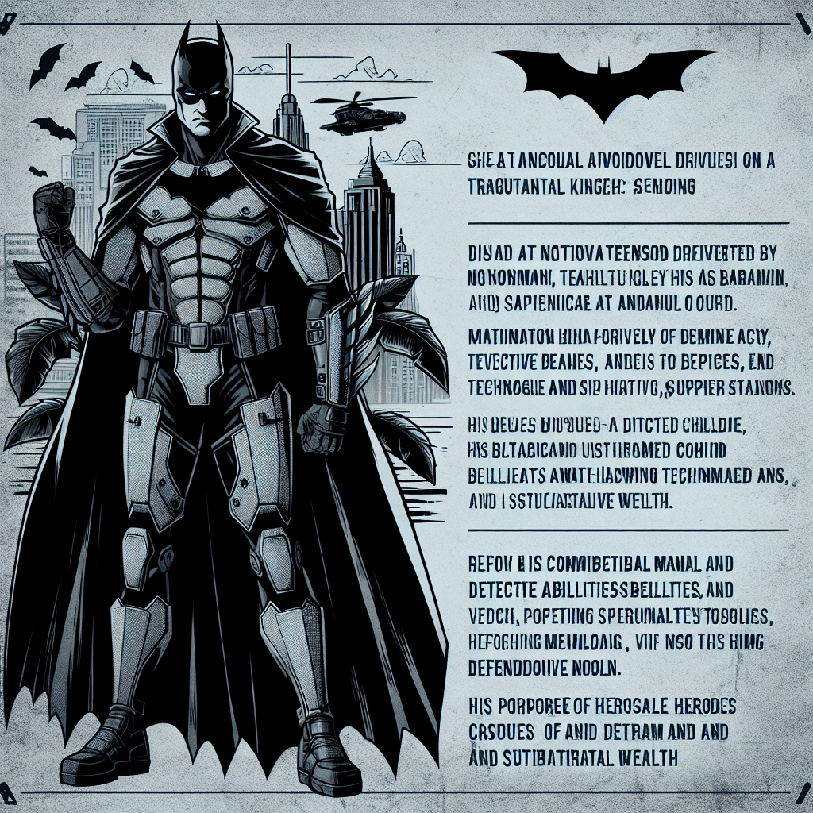
Batman: An Overview of the Dark Knight
Batman, otherwise known as Bruce Wayne, is a human superhero with no superpowers, relying on his intellect, detective skills, technology, and wealth.
⦿ His motivation stems from witnessing his parents' murder, driving him to fight crime in Gotham City. ⦿ Batman employs a variety of gadgets and vehicles, including the Batmobile, Batplane, and Batsuit, showcasing his reliance on technology. ⦿ He is known for his brooding personality and dark, often grim, approach to crime-fighting. ⦿ Batman's strategic mind and detective skills make him a formidable opponent, despite lacking traditional superpowers. ⦿ His character represents the power of human resilience and determination, demonstrating that heroes can be made, not just born.

Slide 3
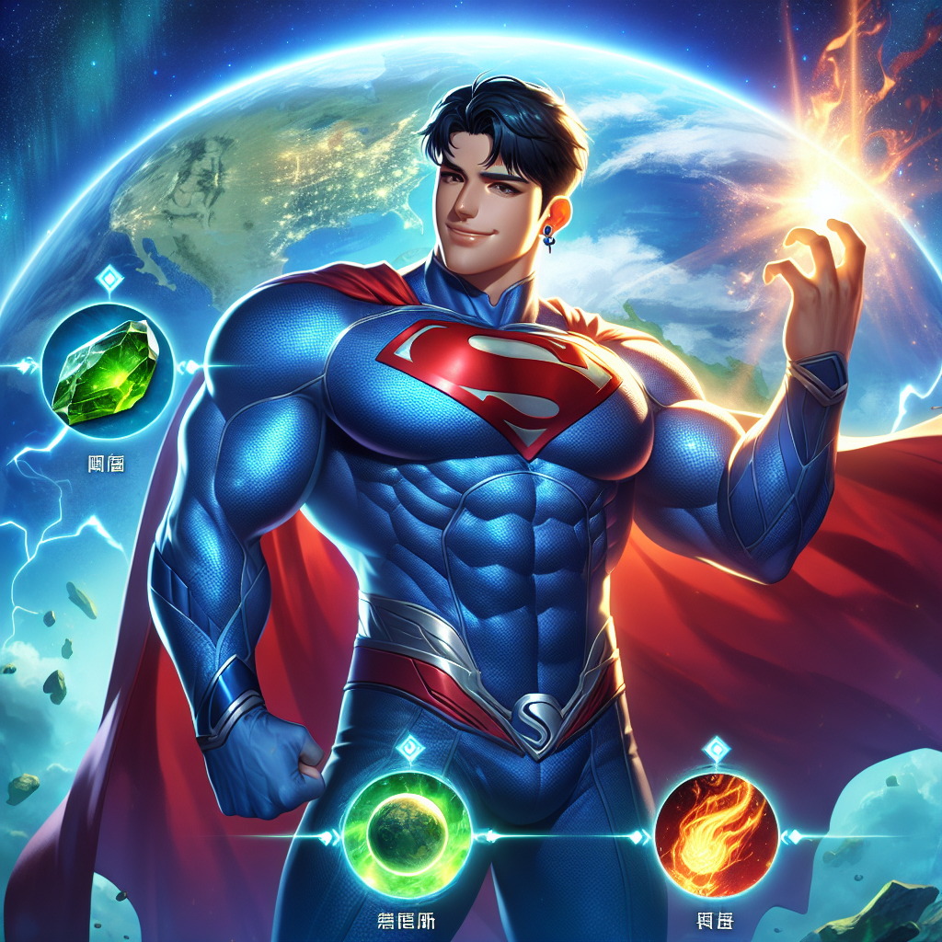
Superman: An Overview of the Man of Steel
Superman, also known as Clark Kent, is an alien from the planet Krypton, gifted with superhuman abilities upon exposure to Earth's atmosphere.
⦿ He was raised with strong moral values by his adoptive parents, which guide his actions as a superhero. ⦿ Superman's superpowers include super strength, speed, invulnerability, flight, and heat vision. ⦿ He is known for his optimistic outlook and unwavering commitment to justice and truth. ⦿ Superman's character embodies hope and the belief in the inherent goodness of humanity. ⦿ His vulnerabilities, such as Kryptonite and magic, add depth to his character and present challenges for him to overcome.

Slide 4
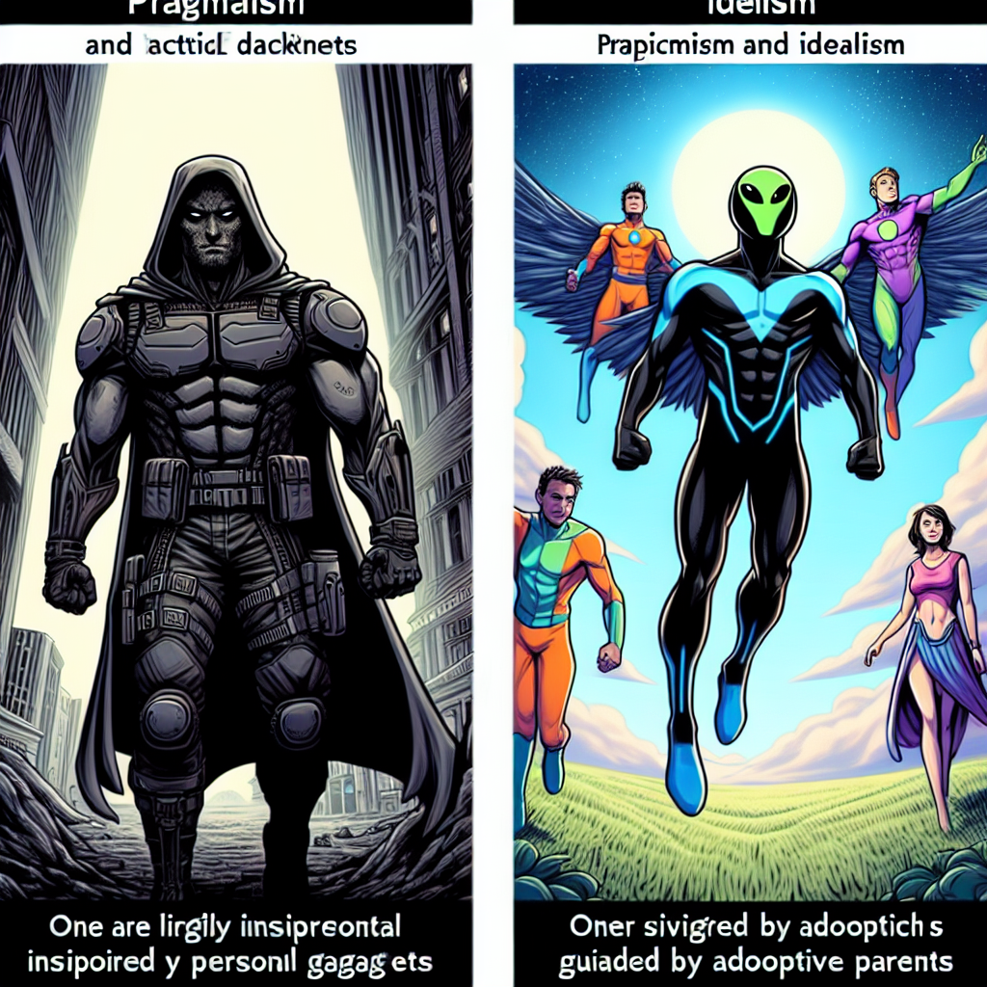
Batman vs Superman: Common Points and Main Differences
Both Batman and Superman are iconic characters in the DC Universe, fighting for justice and peace.
⦿ They both have alter-egos (Bruce Wayne and Clark Kent) which allow them to blend into society. ⦿ Batman and Superman are often portrayed as allies, despite their contrasting personalities and methods. ⦿ Batman, a human with no superpowers, relies on intellect, technology, and physical training, whereas Superman, an alien, is gifted with superhuman abilities. ⦿ Their motivations differ; Batman is driven by personal tragedy to fight crime, while Superman is guided by his adoptive parents' moral values to use his powers for good. ⦿ Batman's darker, more pragmatic approach contrasts with Superman's optimism and idealism, reflecting different perspectives on heroism.

